Slide 1
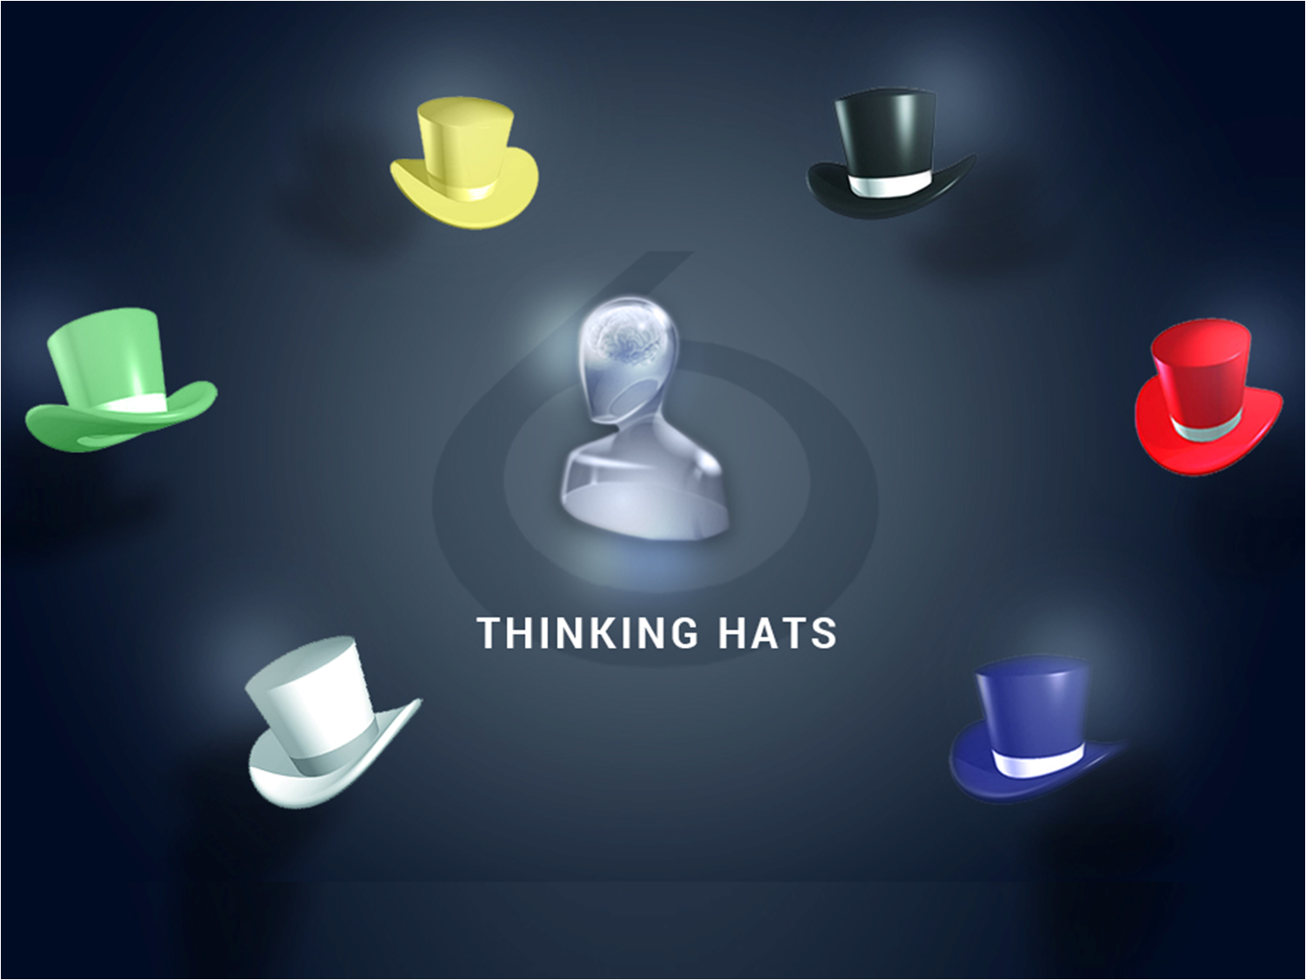

Slide 2
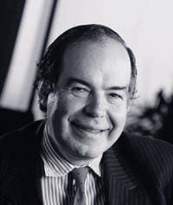
“A discussion should be a genuine attempt to explore a subject rather than a battle between competing egos.”
Dr. Edward De Bono

Slide 3
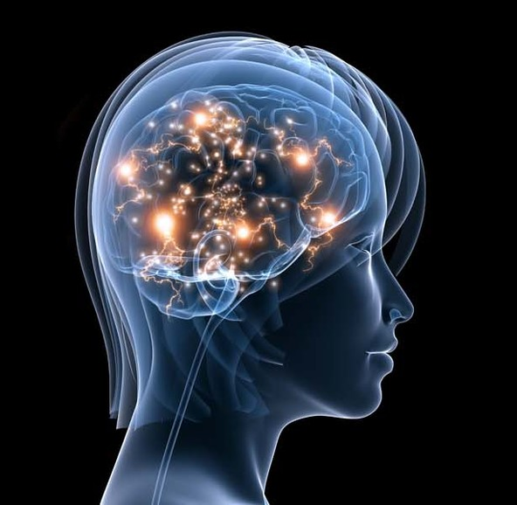
Parallel Thinking
Where each thinker puts forward his or her thoughts in parallel with the thoughts of others, not attacking the thoughts of others.

Slide 4
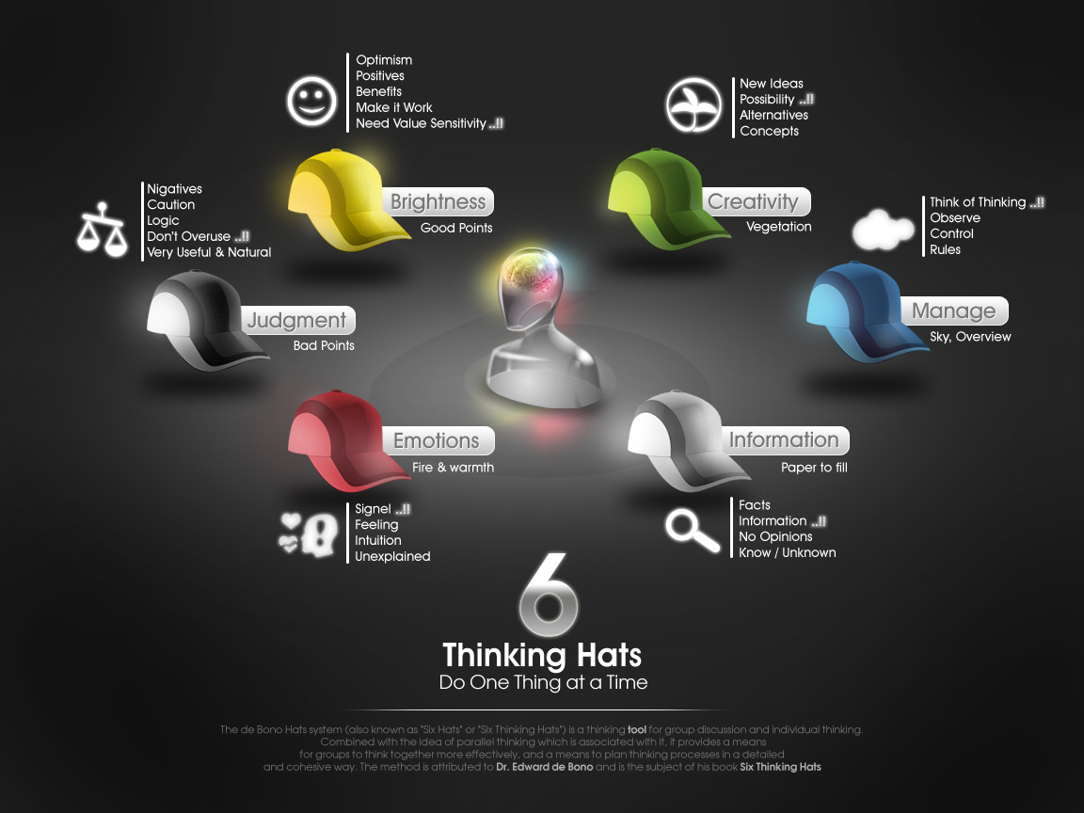

Slide 5
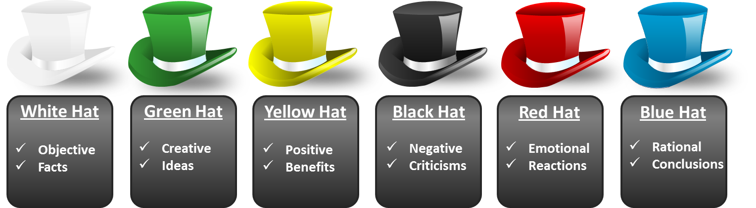
White Hat
When you put on your white hat, you focus directly on
the information – what is available, what is needed, and how it might be obtained. Proposals, opinions, beliefs and arguments should be put aside.

Slide 6
Green Hat
The green hat makes time and space available to focus on creative thinking. Even if no creative ideas are forthcoming, the green hat asks for the creative effort.
Often green hat thinking is difficult because it goes against our habits of recognition, judgment and criticism.

Slide 7
Yellow Hat
Yellow hat thinking is a deliberate search for the positive. Benefits are not always immediately obvious and you might have to search for them.
Every creative idea deserves some yellow hat attention.

Slide 8
Black Hat
Mistakes can be disastrous. So the black hat is very valuable. It is the most used hat and possibly the most useful hat. However, it is very easy to overuse the black hat. Caution, used too early in the problem-solving process, can easily kill creative ideas with early negativity.

Slide 9
Red Hat
Allowing feelings to come into the discussion without pretending to be anything else is always valuable to get feelings out into the open.

Slide 10
Blue Hat
The overview or process control. It is for organizing and controlling the thinking process so that it becomes more productive. The blue hat is for thinking about thinking.

Slide 11
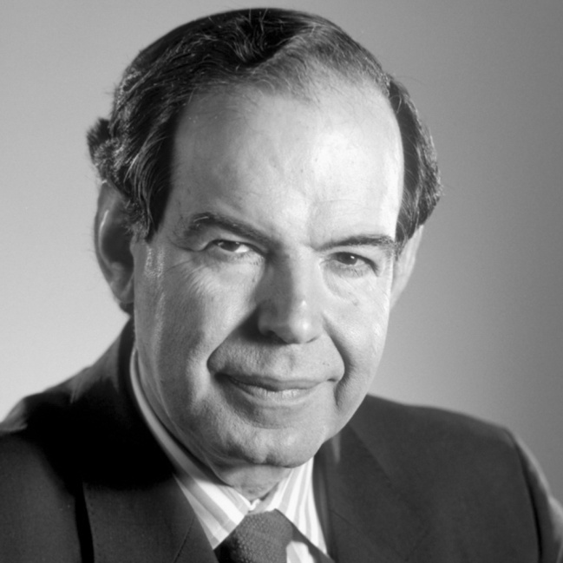
“Logic will never change emotion or perception”
Edward De Bono

